Slide 1
Dr. Robert C. Vander Meer
January 16, 1930 • May 30, 2024

Slide 2
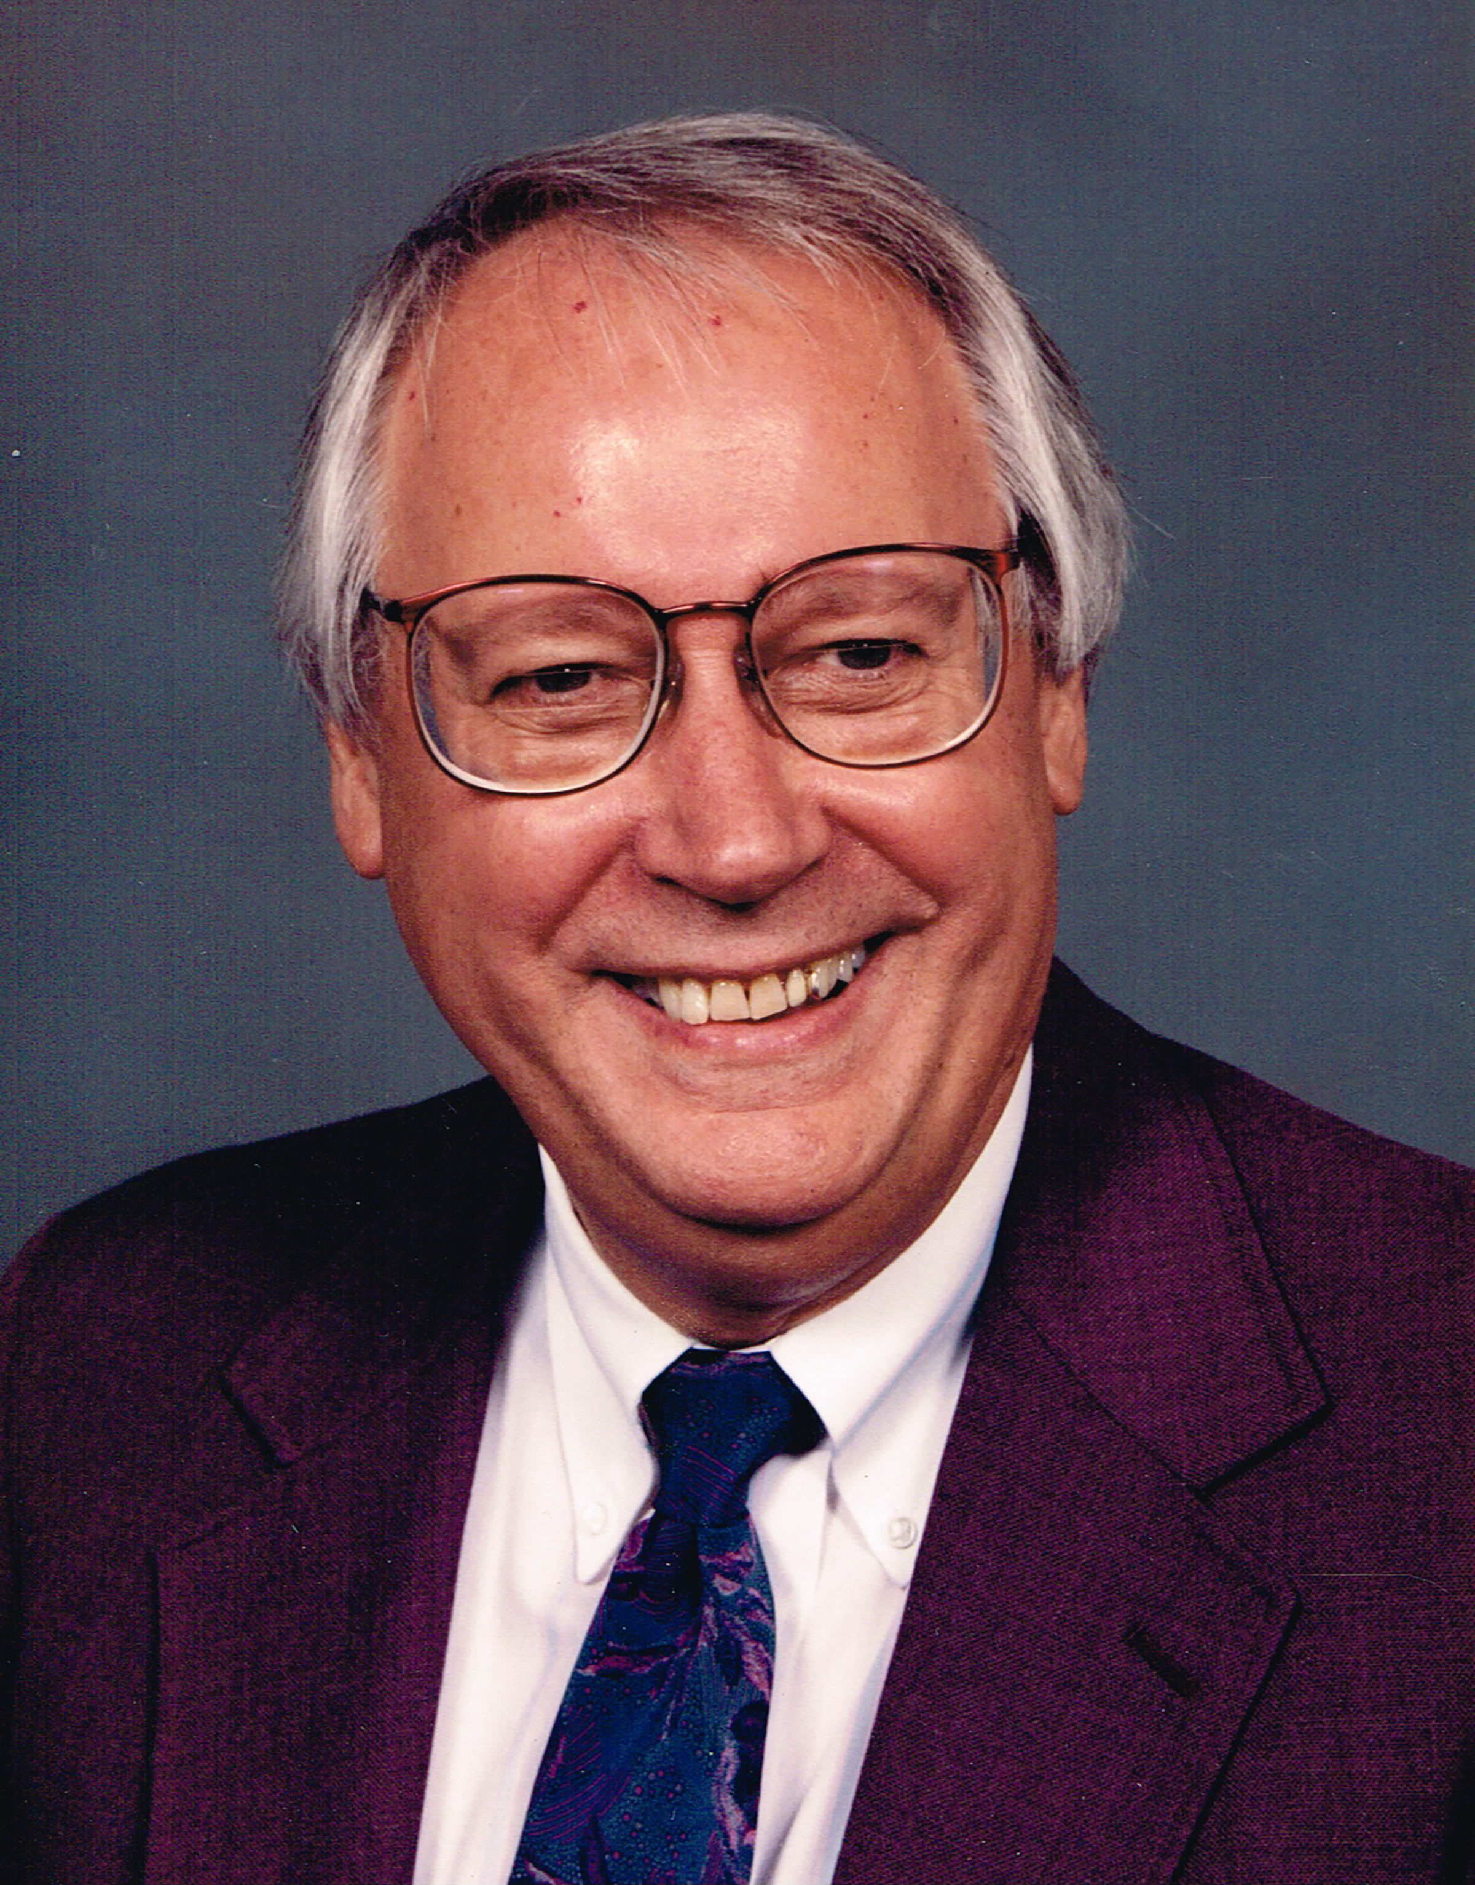
An Iowa Farm Boy and Successful Optometrist
Among his many accomplishments, Bob served on the New Mexico Board of Examiners in Optometry for three terms, was president and legislative chair of NMOA and voted Optometrist of the Year twice, served for 10 years on the Western Interstate Commission in Higher Education, operated private practice offices in Las Vegas, Clayton and Boise City, Okla., and worked with the Lions Club of Las Vegas for decades providing free and low-cost eye wear to children and adults in need.

Slide 3
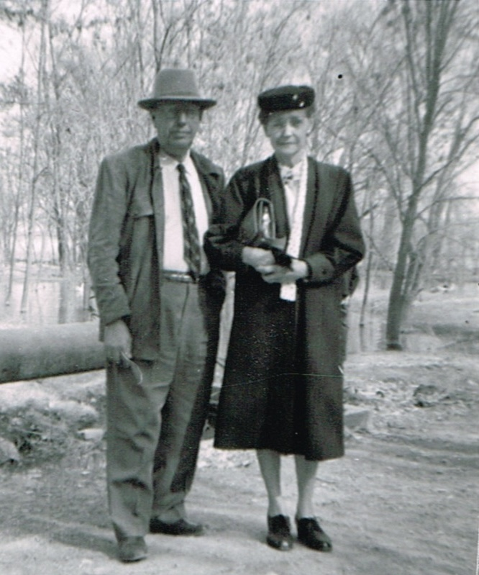
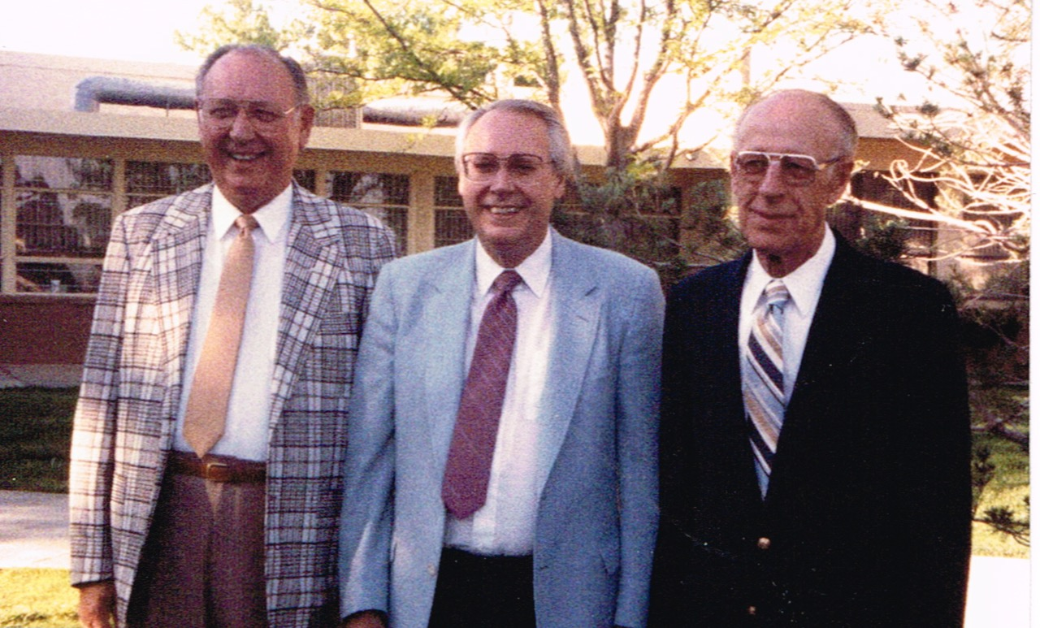
Charles and Kate Vander Meer and Bob with his brothers, Willis and Roy.

Slide 4
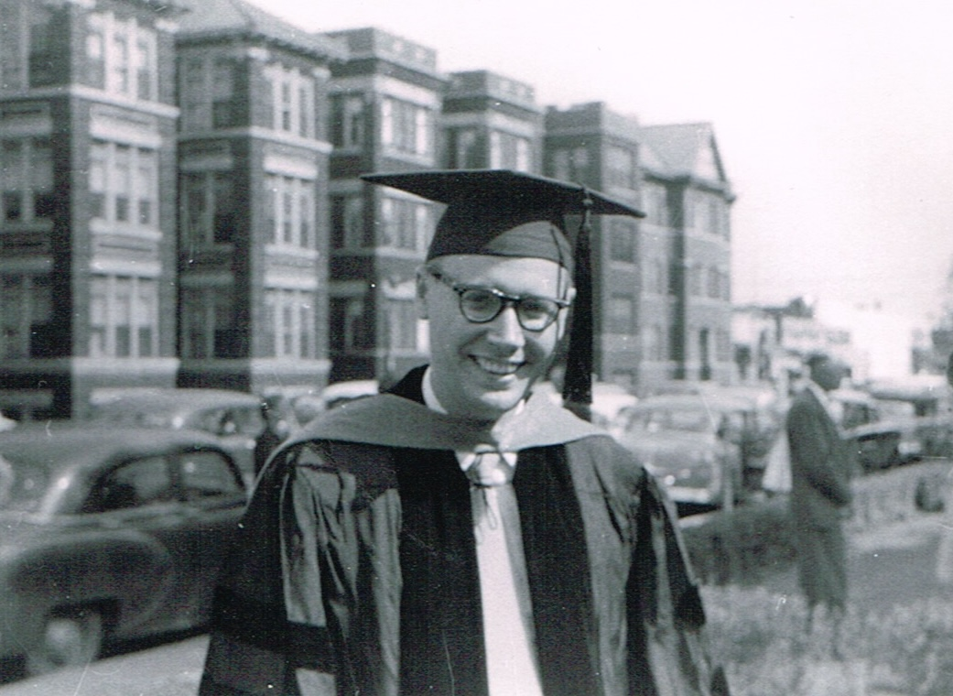
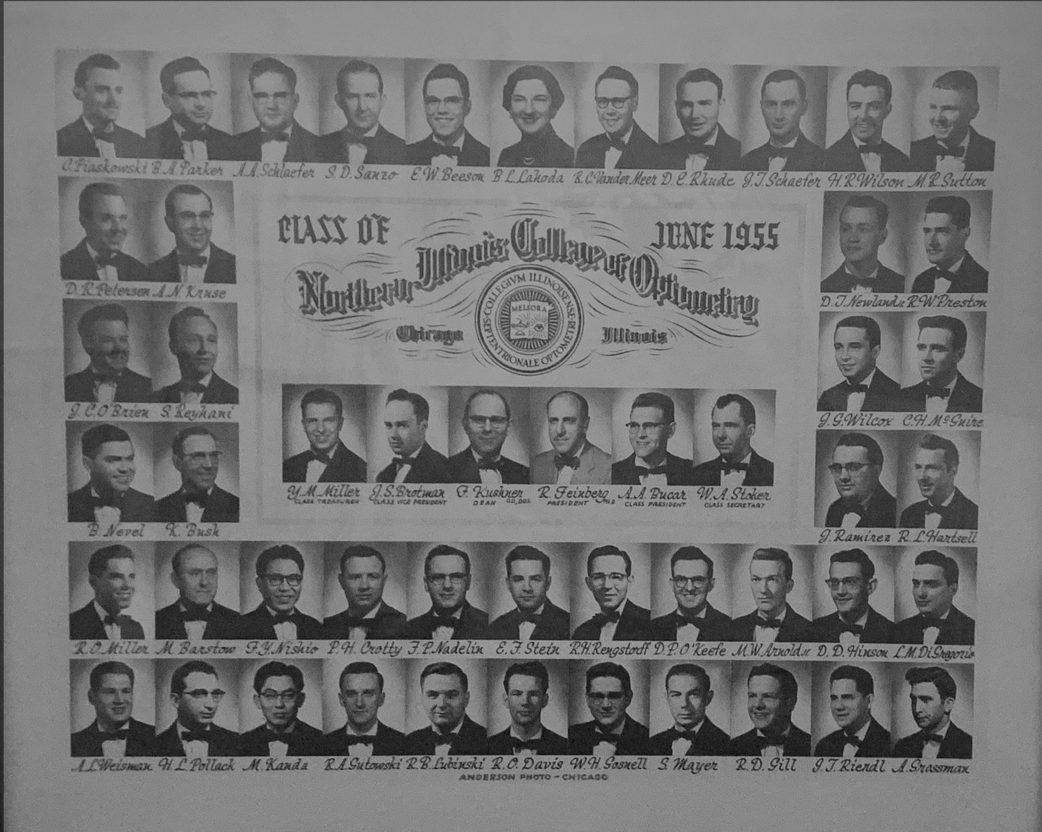
Bob was proud of his education and his 61-year career as an optometrist.

Slide 5
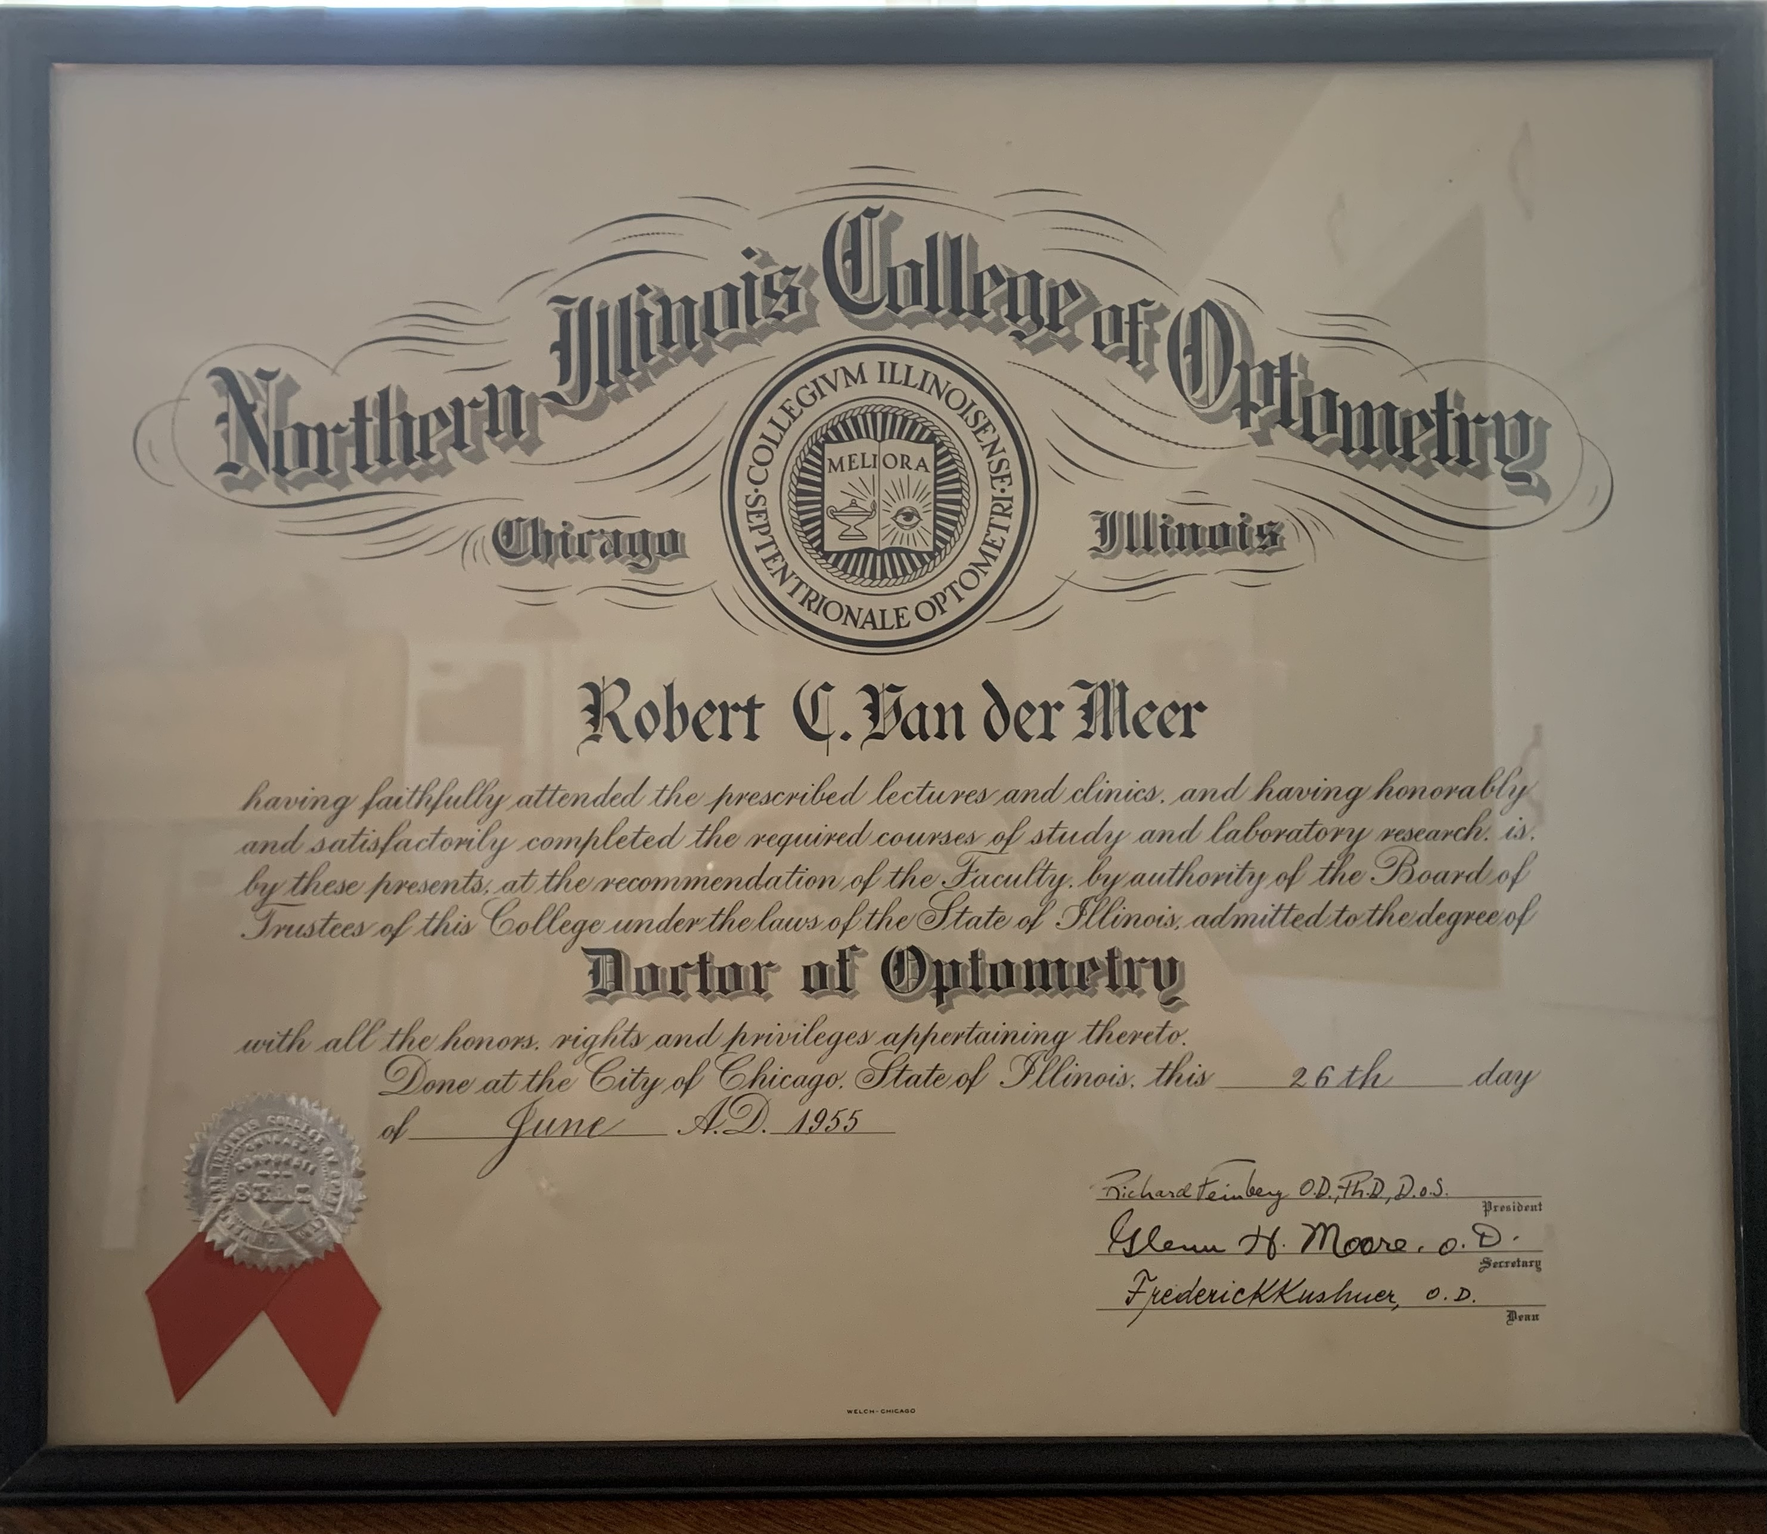

Slide 6
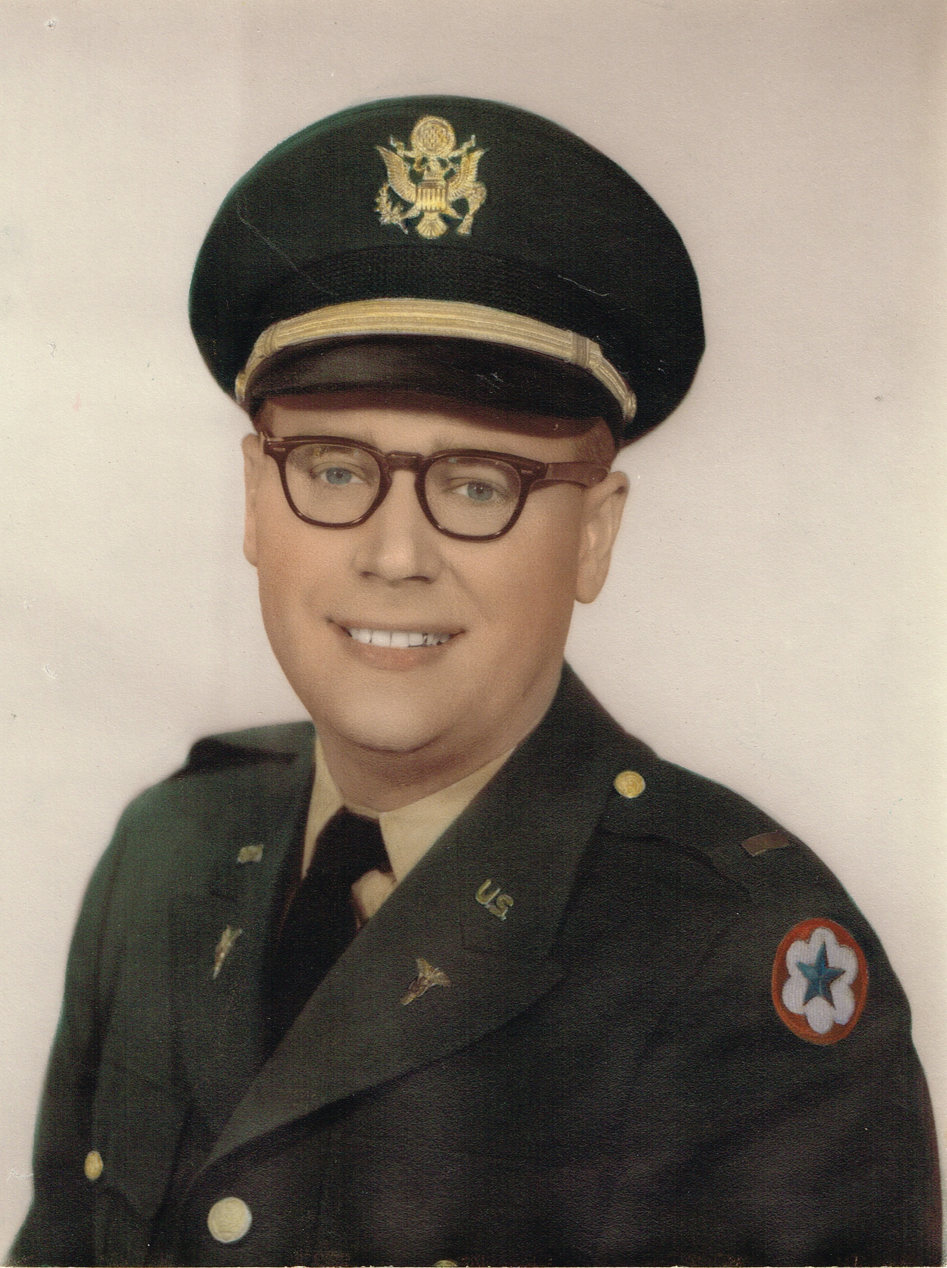
Bob received a seven-year deferment to attend college and optometry school and paid it back by serving in the army, stationed first at Beaumont Hospital in El Paso and later at Holloman AFB where he not only worked with humans, he also worked with chimpanzees, among them HAM, the chimp who went into space.

Slide 7
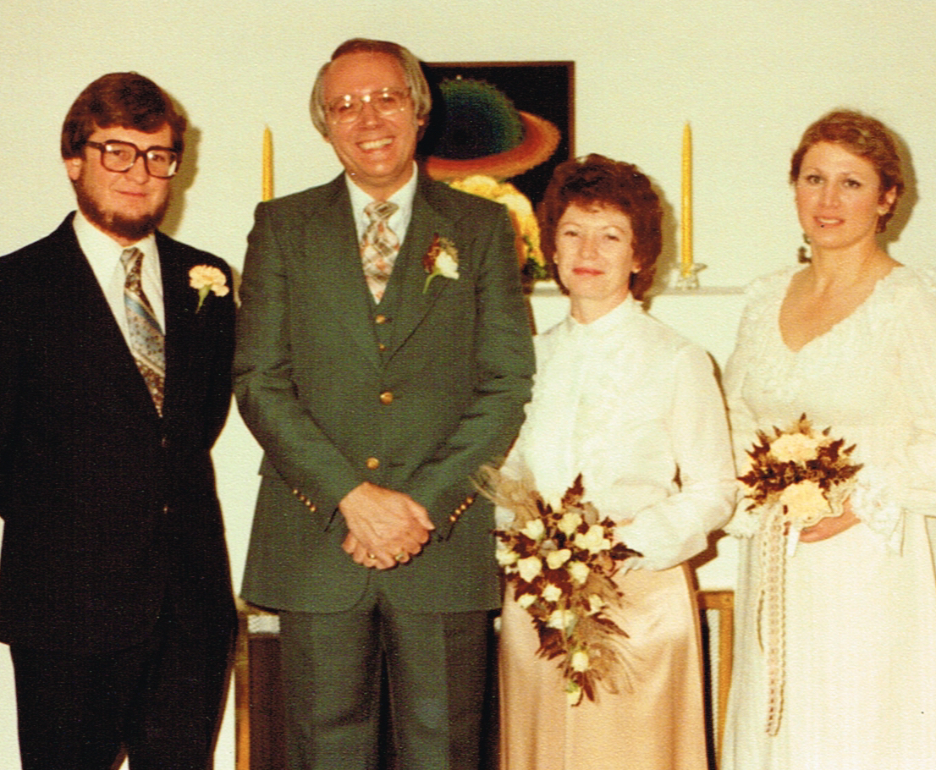
Bob married his dear wife Sharon, December 29, 1980. Pictured here with Sharon’s brother Marc, and his wife Lisa.

Slide 8
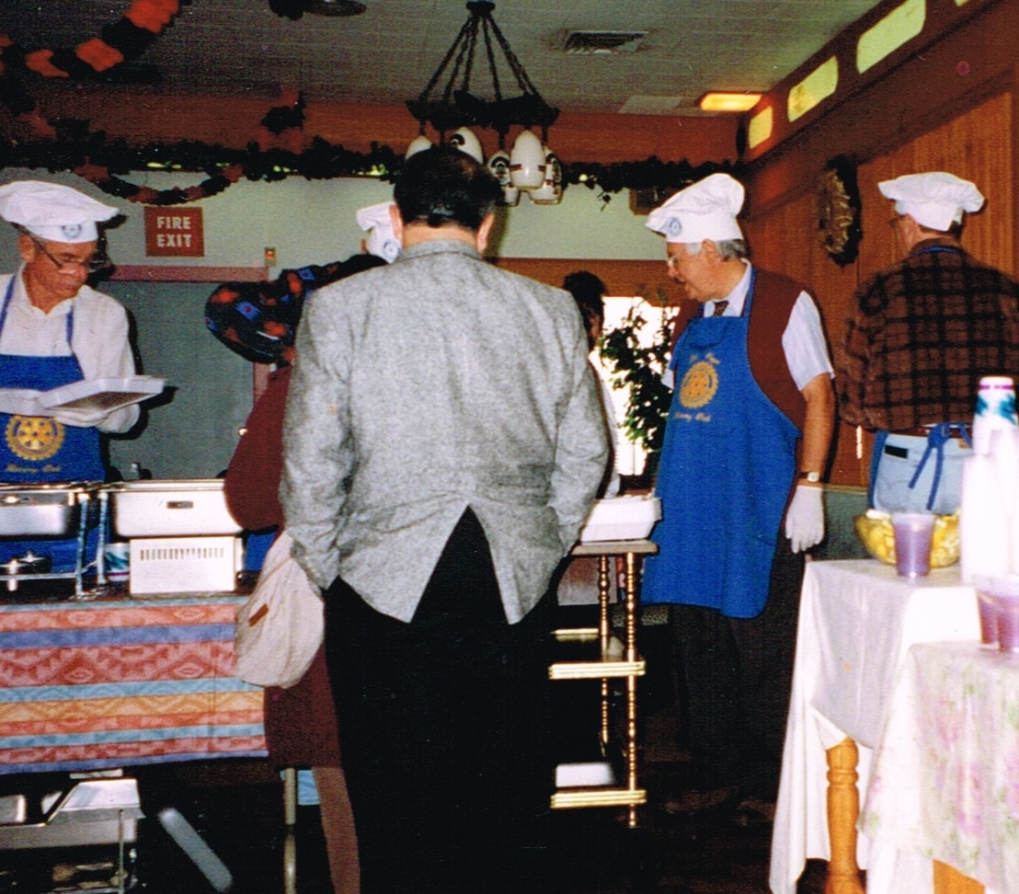
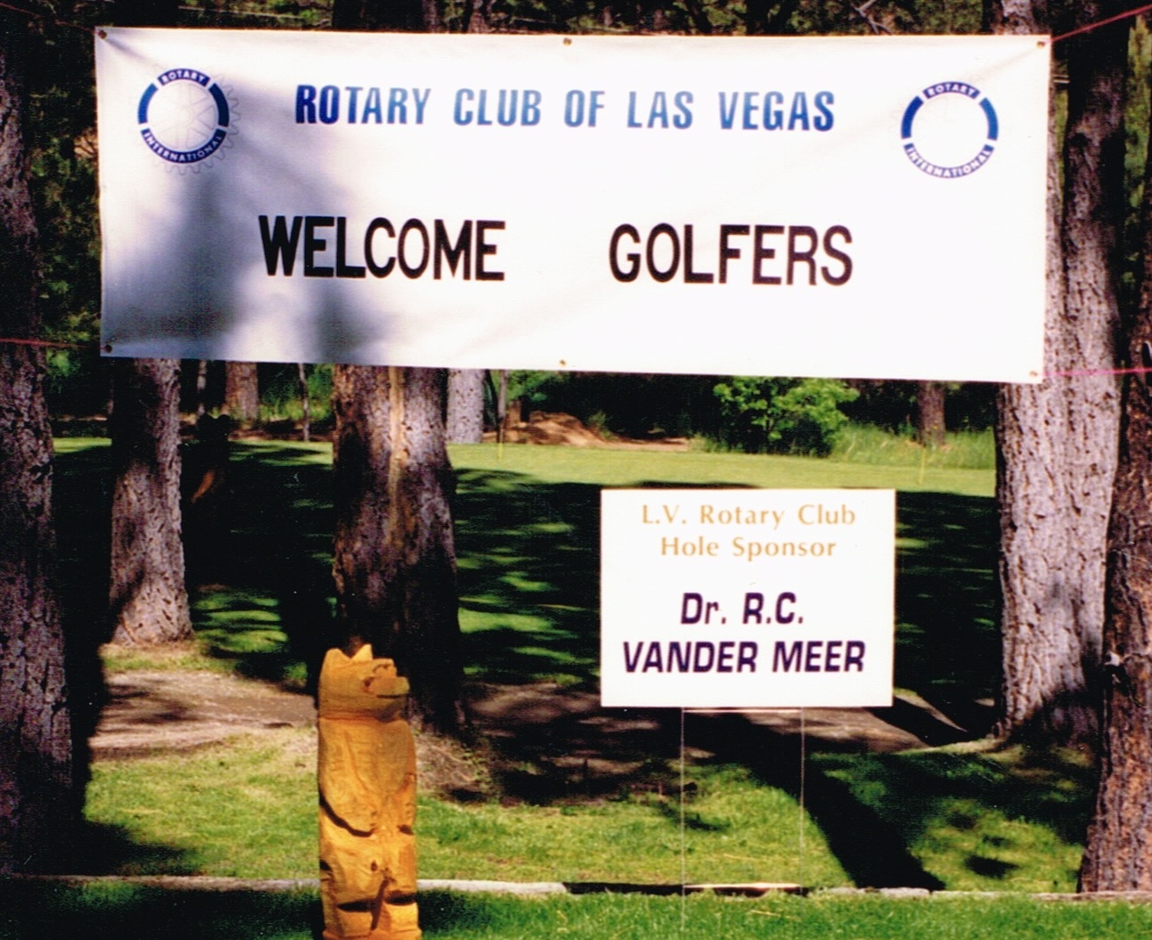
Rotary Club of Las Vegas was one of Bob’s favorite things to do away from work. He served as president, club service chair and was sponsor of the the golf tournament for many years.

Slide 9
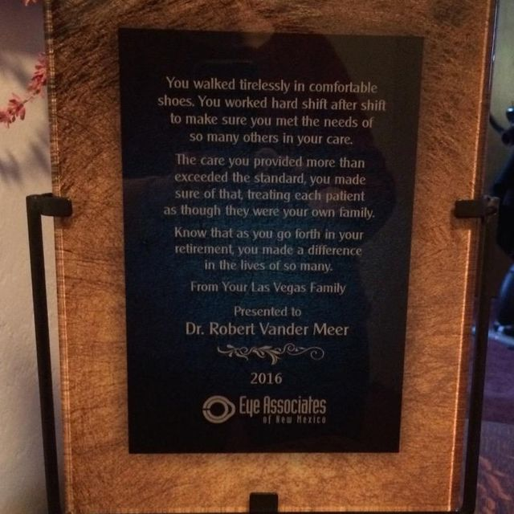
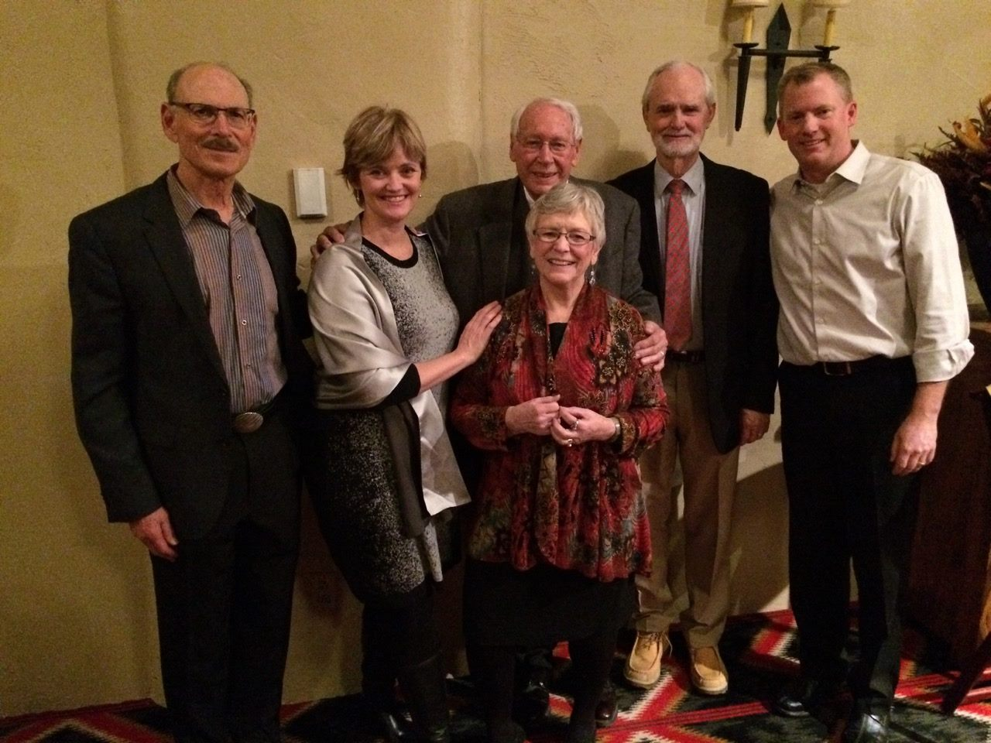
After 61 years in practice, 51 as an independent practitioner and 10 working with Eye Associates of New Mexico, Bob retired in 2015.

Slide 10
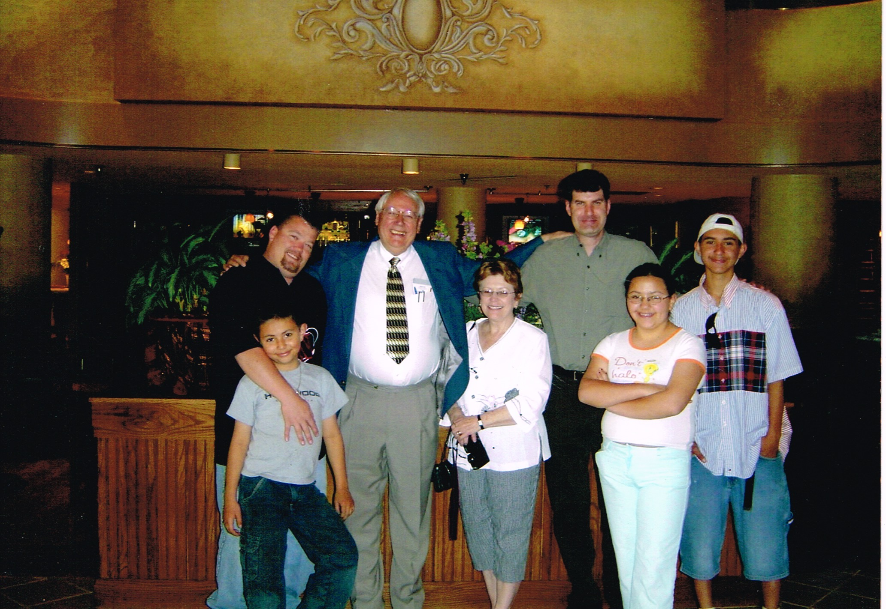

Slide 11
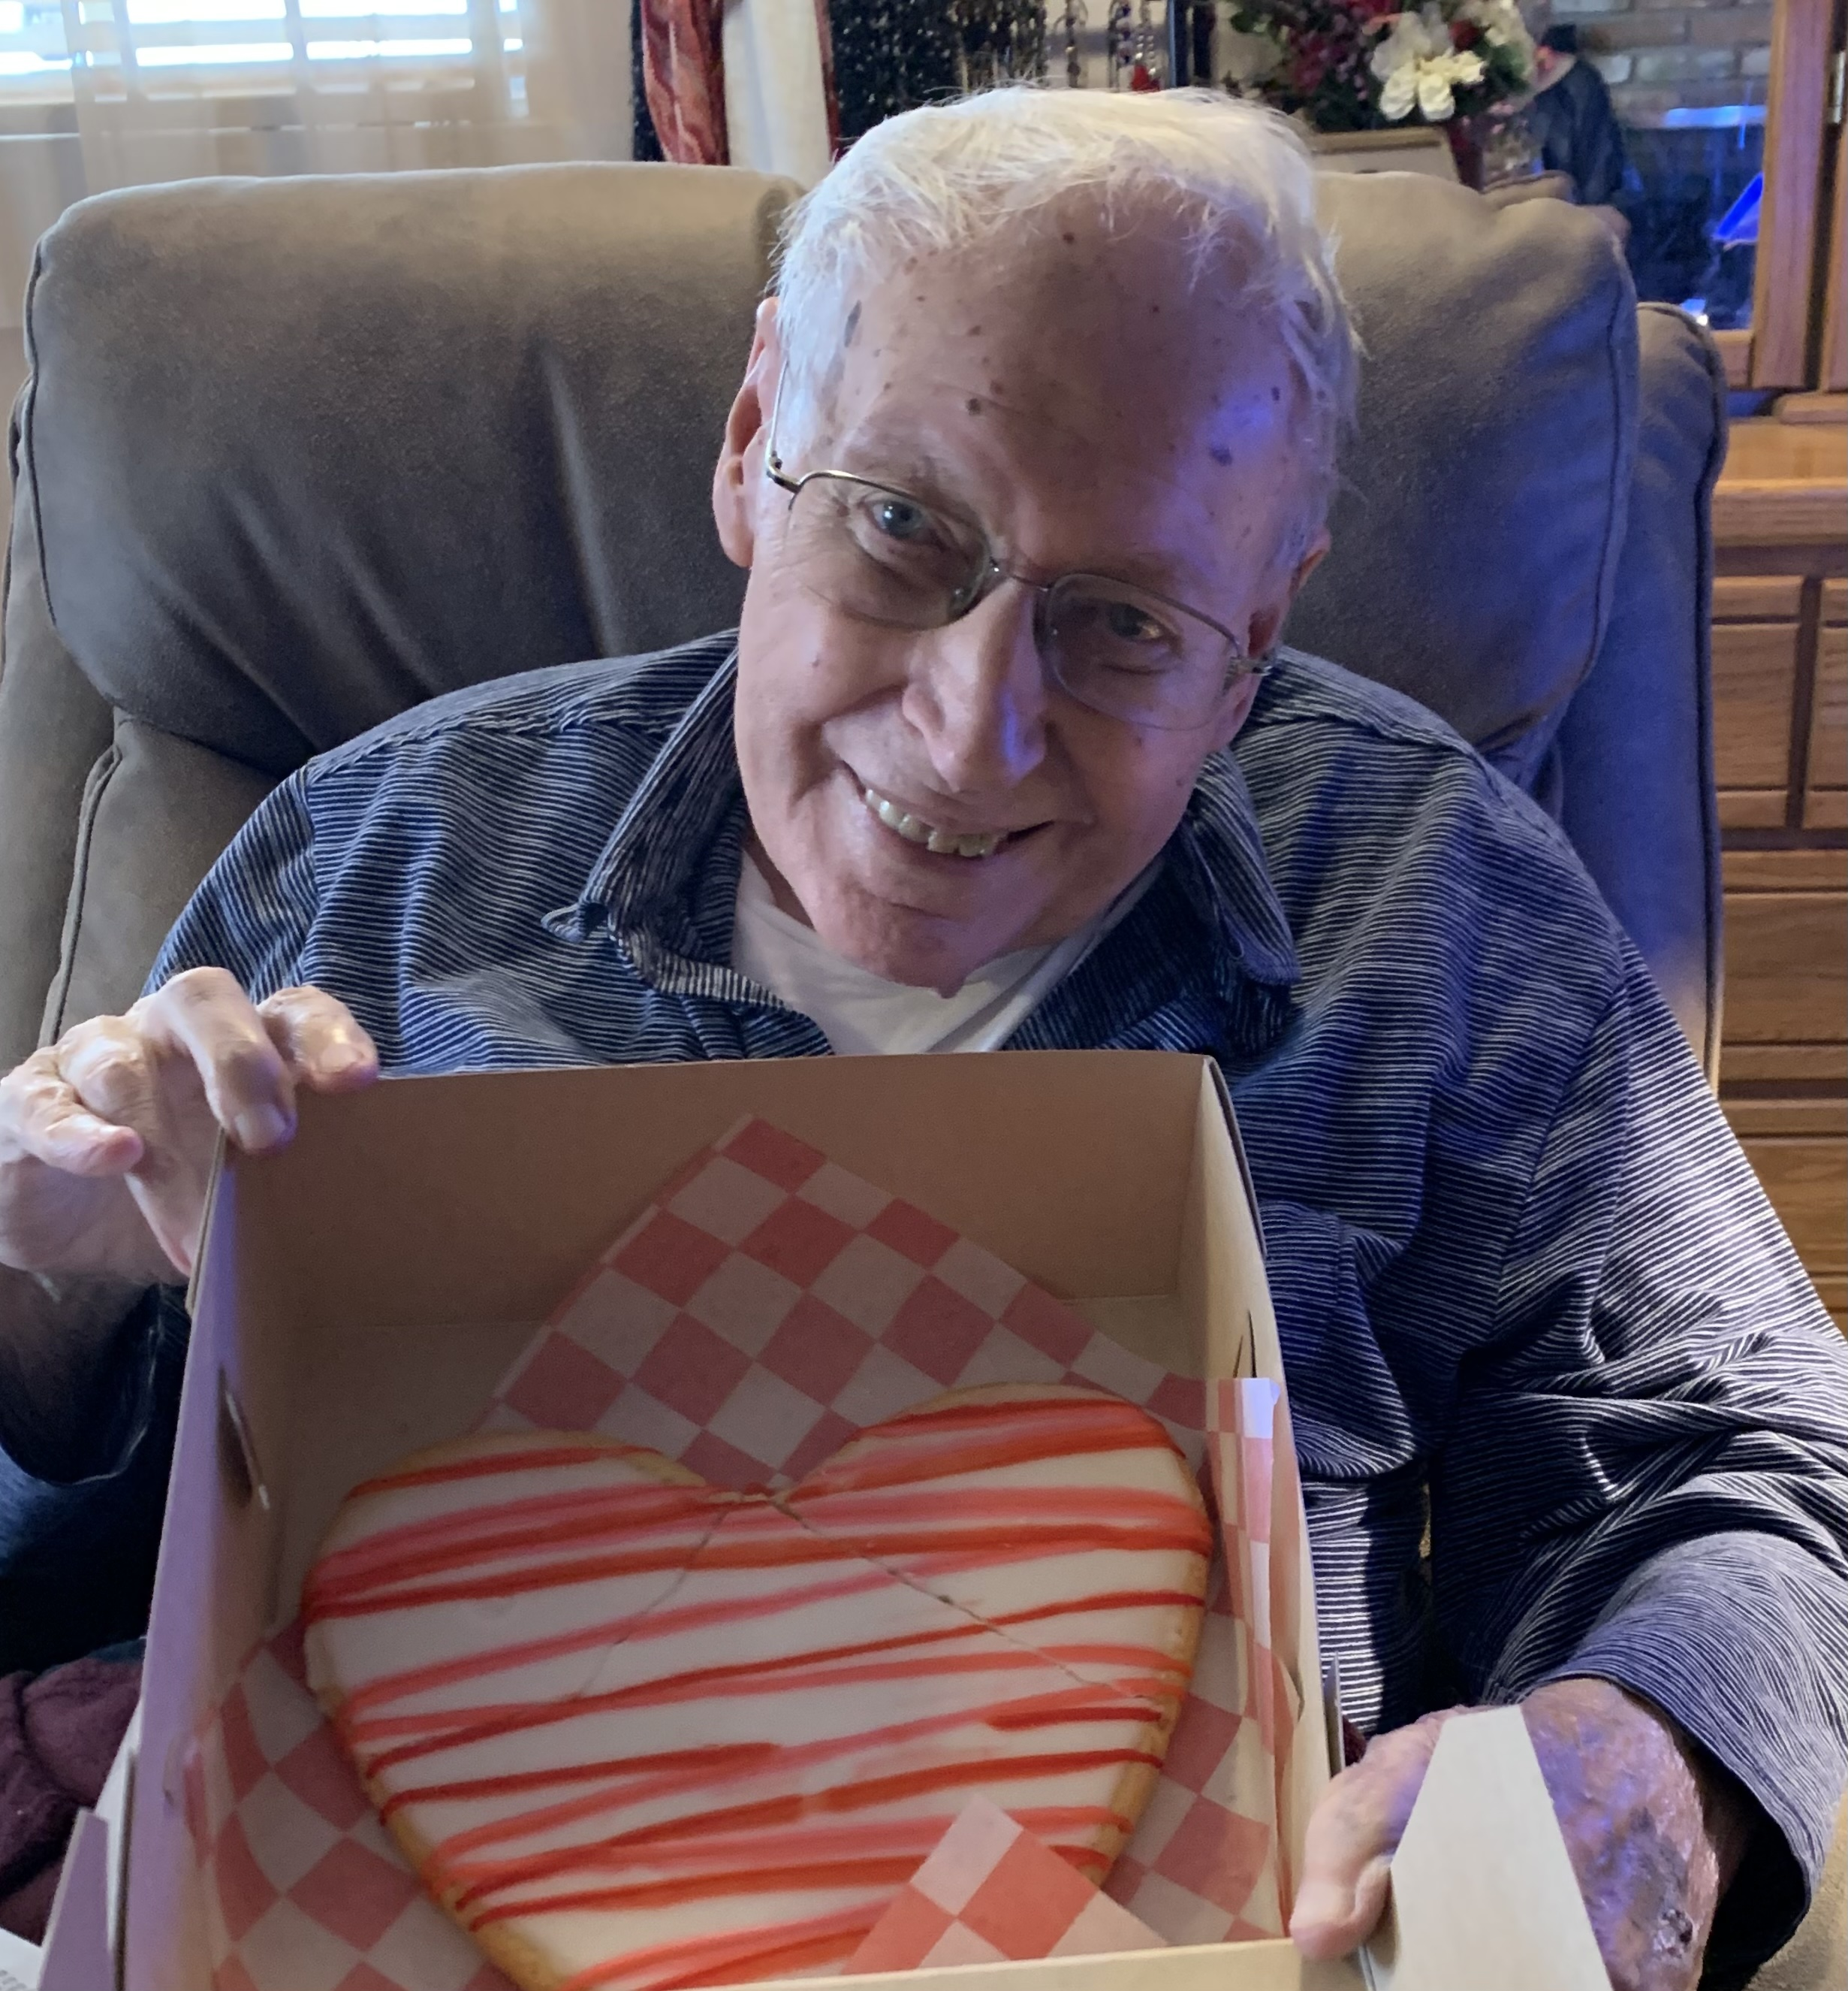
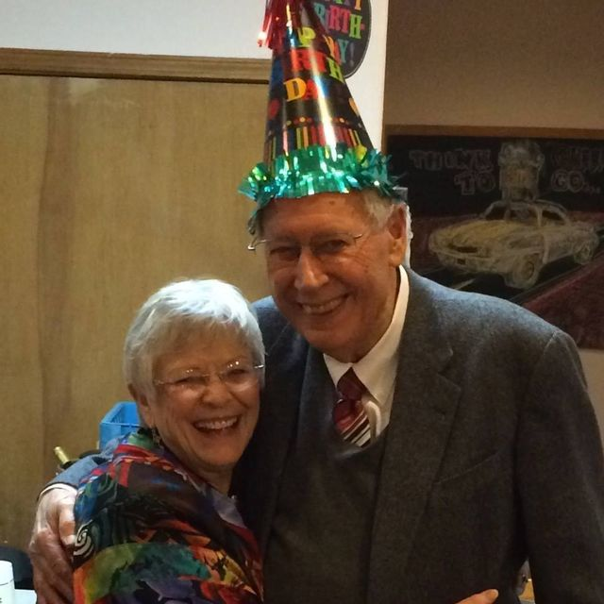
A couple of Birthday Celebrations!

Slide 12
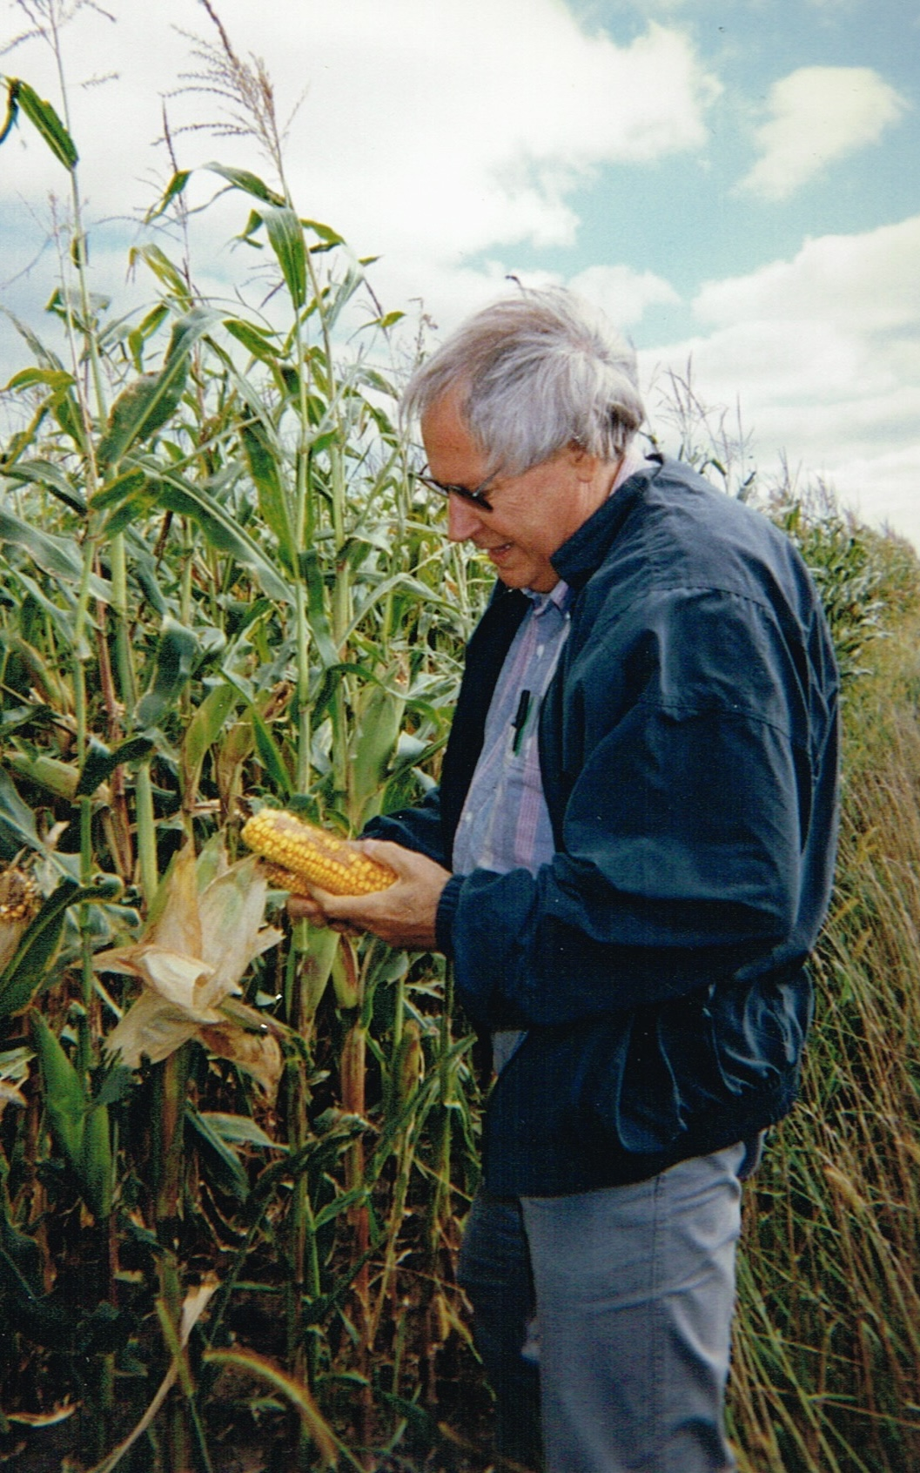
MEMORIES
Laughter and tears, one heart to another we bonded in love and blossomed in the garden of life. I miss you, my dearest.
Thanks for the memories.
––Sharon Vander Meer

